Slide 1
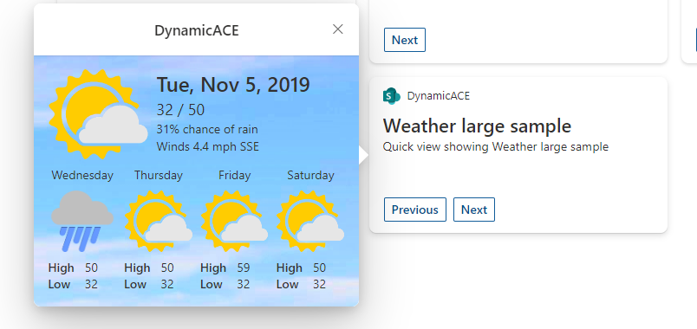
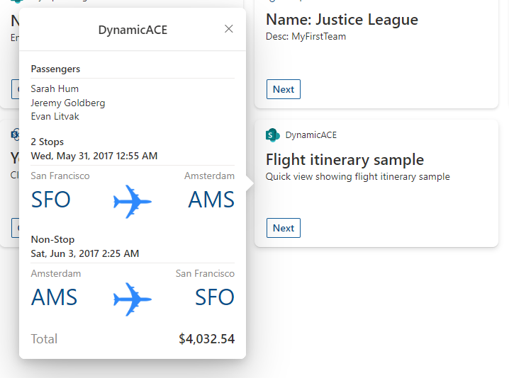

Dynamic Announcements Adaptive Card Extension (Viva Connection)
PrimaryTextCard-Dynamic-Announcements
Siddharth Vaghasia (@siddh_me)

Slide 2





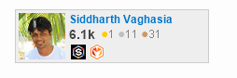






Siddharth Vaghasia
https://siddharthvaghasia.com
https://c-sharpcorner.com/members/siddharth-vaghasia
@siddh_me
siddharth-vaghasia
https://www.linkedin.com/in/siddharthvaghasia

Slide 3

PrimaryTextCard-Dynamic-Announcements
ACE component to show multiple cards/items from a SharePoint list at a time based on dates
https://github.com/pnp/sp-dev-fx-aces/tree/main/samples/PrimaryTextCard-Dynamic-Announcements

Slide 4
Summary
Single ACE component to show various cards/items from a SharePoint list at a time based on dates
Dynamic Announcement from SharePoint list
Can render different Adaptive card formats as Quick View based on individual SharePoint list item
On click of the Card View, it can open either an External URL or Quick view or no action based on the item's configuration(OnCardSelectionType)
Example – Show Communication, Important updates, Quotes of the day, Tip of the day or any other annoucments…

Slide 5
Other Features
Option to create List from configuration Panel
Option to enable Auto Rotate card every 4 seconds
Prev and Next button to navigate through different items
Same card be added multiple times on Dashboard pointing to different lists.

Slide 6
Demo/ Code Walkthrough

Slide 7
THANK YOU

